Slide 1
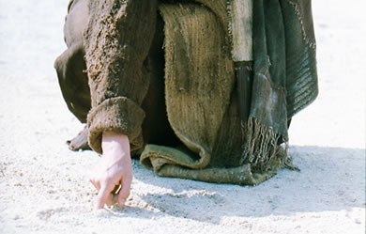
Christ's Writing Ministry
Tiến sĩ Rick Griffith • Trường Kinh Thánh Singapore • www.BibleStudyDownloads.org
Notes:
We have NO actual accounts of Jesus writing anything except what he wrote in the sand in John 8—and we have no idea what he wrote!

Slide 2

If Jesus wrote a letter to your church, what would Jesus say?
K
Khải huyền

Slide 3
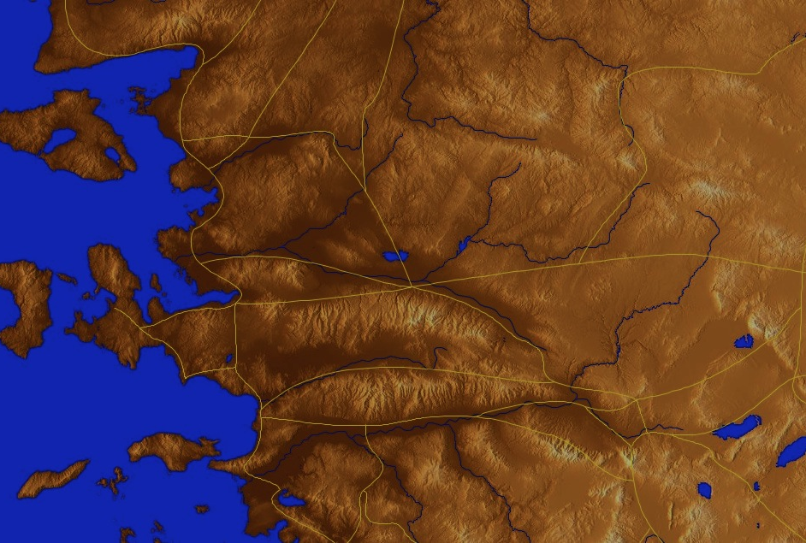
Asia Minor in AD 95
345
Adramyttium
Aezani
Cyme
Erythrae
Eumenia
Lebedus
Colophon
Nysa
Hierapolis
Trailes
Heraclea
Aphrodisias
Colossae
Alabanda
Patmos
Miletus
Notes:
In AD 95 John was exiled to the lonely island of Patmos out in the Adriatic Sea. Jesus Christ had a Khải huyền of comfort to the suffering believers of Asia Minor, but how could this message reach them?

Slide 4
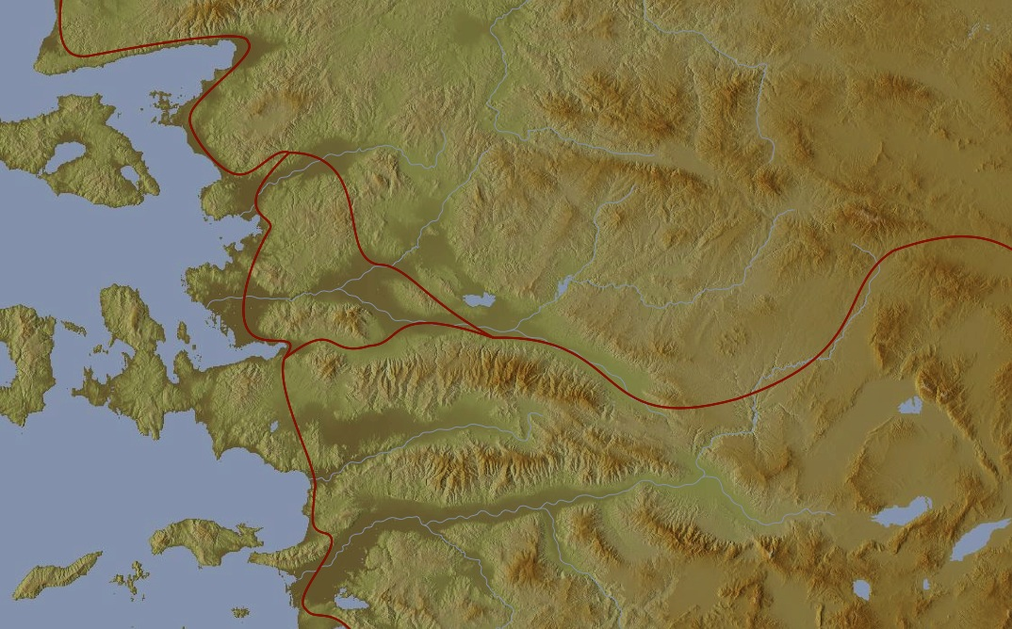
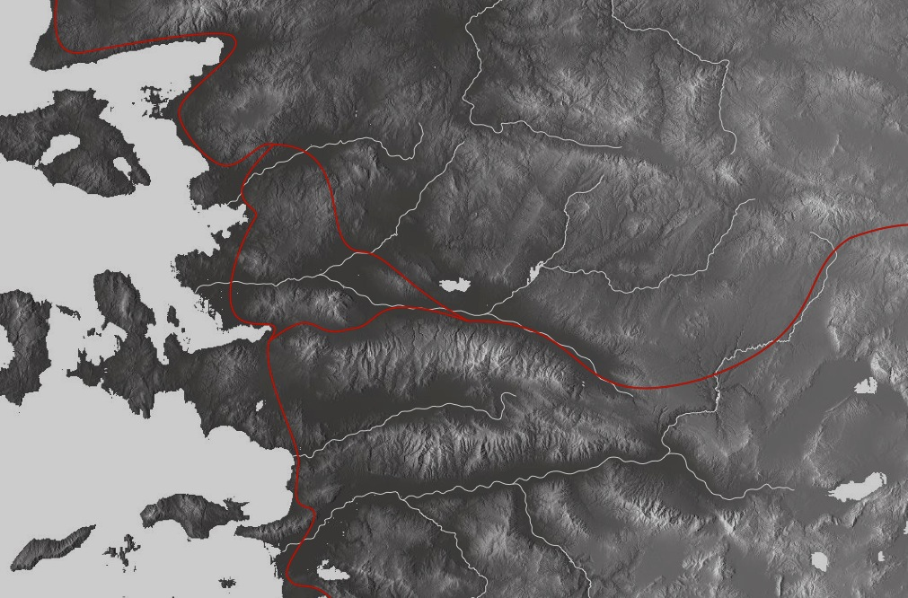
The 7 Churches (Rev. 2–3)
345
Adramyttium
Aezani
Pergamum
Thyatira
Cyme
Erythrae
Sardis
Smyrna
Eumenia
Philadelphia
Lebedus
Colophon
Ephesus
Nysa
Laodicea
Hierapolis
Trailes
Heraclea
Aphrodisias
Colossae
Alabanda
Patmos
Miletus
Notes:
Jesus designed a brilliant strategy by having his Khải huyền sent to capital of the province, Ephesus. It included an individual letter to Ephesus, as well as letters to 6 other key churches. The Ephesians copied the entire book of Khải huyền, though, and sent the original to the next city, Smyrna. Smyrna then made their own copy and sent the original to Pergamum, which lay on the main road to the north. This city then sent the prophecy to Thyatira, which sent it to Sardis, then Philadelphia, and finally to Laodicea.

Slide 5
The 7 Churches (Rev. 2–3)
345
Pergamum
Thyatira
Sardis
Smyrna
Philadelphia
Ephesus
Laodicea
Notes:
These 7 churches were neither the largest, nor the most influential cities in Asia Minor. However, they were strategically located on a key highway that linked them all.
[Animate} From their own locations we understand that they also copied the prophecy and sent these copies to other churches near them.

Slide 6
7 Church Stages?
347
Mistreated yet Missions-Minded
Suffering yet Steadfast
Continuing yet Compromising
Distinguished yet Dead
Busy yet Backslidden
Involved yet Immoral
Luxurious yet Lukewarm
Modern Missions Era
Reformation
Constantine
Middle Ages
Materialistic
Apostolic Age
Church Fathers
33
100
313
476
1453
1795
1900
Philadelphia
Ephesus
Smyrna
Pergamum
Thyatira
Sardis
Laodicea
Notes:
Some scholars over the years have believed that these churches represent 7 stages of church history:
33—The Apostles of Christ pass on the gospel, but by AD 95 the love at Ephesus had grown cold
100—Last Apostle died (John) with the message passed on to their disciples, called the "Church Fathers"
313—Constantine began to merge Christianity and paganism. With paganism illegal, it took on a "Christianized" form.
476—Rome's Fall ushered in 1000 years of deviation from classical learning called the "Middle Ages" with Rome's influence through the RCC
1453—The conquest of Constantinople by the Turks began the Renaissance, followed by the Reformation
1793—William Carey left England for India, sparking the movement of the gospel from the West to the Two-Thirds World
1900—The decline of Christianity in Europe began to be replaced with humanism, materialism, modernism, and post-modernism

Slide 7
Four Views on Rev. 2–3
345
Pergamum
Historic
Churches
Historico-
Prophetical
Prophetic View
Thyatira
Sardis
Smyrna
Philadelphia
Ephesus
Laodicea
Typical (Representative)
Notes:
Four Views:
Historic Churches: The 7 churches were actual churches at John’s time. All actually hold to this view except Bulllinger, who in 1935 taught seven churches are seven Jewish congregations in the future Tribulation period. Almost all see these as depicting seven churches that can be found in any age.
Prophetic: The chapters deal purely with stages of church history without identifying any first century church, shown by remarkable resemblance to successive eras of church history (taught by Cohen, Understanding Khải huyền, 48-49; and J. A. Seiss, The Apocalypse [London: Marshall, Morgan, and Scott, n.d.], 76-86).
Historico-Prophetical: The churches depict BOTH historic churches of the first century and stages of church history. “This approach is commonly taken in dispensational commentaries; see e.g., Herman A. Hoyt, The Khải huyền of the Lord Jesus Christ (Winona Lake, IN: BMH, 1966) 17,25-29, and John F. Walvoord, The Khải huyền of Jesus Christ (Chicago: Moody, 1966) 52, who holds the view cautiously. See also Menno J. Brunk, "The Seven Churches in Khải huyền 2-3," BSac 126 (1969) 240-46, and Gary G. Cohen, Understanding Khải huyền (Collingswood, NJ: Christian Beacon, 1968) 44-65, who presents a more impressive argument. Of course, the prophetic view is held by non-dispensationalists as well (e.g., J. P. Lange, Commentary on the Holy Scriptures- Khải huyền [reprint; Grand Rapids: Zondervan, n.d.] 139). See also the survey of R. C. Trench, Commentary on the Epistles to the Seven Churches in Asia (6th ed., rev.; reprint; Minneapolis: Klock and Klock, 1978) 237-45” (James L. Boyer, “Are the Churches of Khải huyền 2–3 Prophetic?” Grace Theological Journal 6.2 [1985] 267-273). He answers YES.
Typical (Representative): They were real churches, but also represent types of churches found throughout church history. Therefore, this view is also called the typical or representative view.
Critique of Each View:
Historic Churches: The doubt about whether all of the churches existed is flawed—just because we don’t know about each of them does not mean they did not exist (argument from silence)
Historico-Prophetical: Church history had not 7, but 3, stages: Ancient (to 590), Medieval (590-1517), and Modern (1517-present); designations are arbitrary (e.g., is Sardis pre-Reformation or the Reformation itself?)
Prophetic: (a) Any prophetic element would destroy the doctrine of imminency, so the chapters must relate only to actual first century churches since the 4th and 6th letters refer to Christ’s imminent coming, and Philadelphia would be given a false hope of deliverance from wrath (3:10) if the church had to wait until the “Laodicean age.” (b) Nothing in these chapters or elsewhere in the NT hint at these being stages of church history. (c) These letters differ from the prophetic portions of the book (Rev. 4–22) in that they are simply epistles similar to those written by Paul.
Typical (Representative): (a) Imminency would be ruined only “if it stated explicitly there would be a period of at least two thousand years before the second advent, or even if it had stated explicitly that there would be ‘seven periods of church history’ (Boyer, 269-70. (b) These seven churches do not represent all types of churches of the first century or any other, for other types exist besides these (e.g., Galatian or Corinthian), and “seven” better pictures the whole of the church age than would the 3 stages proposed above.

Slide 8

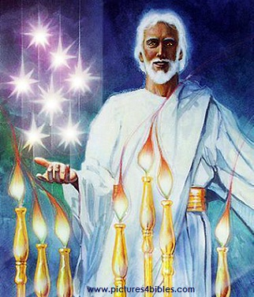
What are the 7 Stars & 7 Lampstands (1:20 NLT)?
tức là sự mầu nhiệm của bảy ngôi sao mà ngươi thấy trong tay hữu ta, và của bảy chơn đèn vàng. Bảy ngôi sao là các thiên sứ của bảy Hội thánh, còn bảy chơn đèn là bảy Hội thánh vậy.

Slide 9
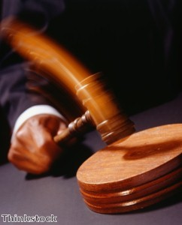
Christ has authority over all churches
344

Slide 10
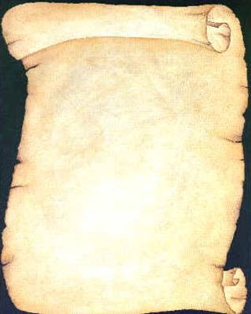
So Jesus wrote 7 churches (Rev. 2–3)
Ephesus
Smyrna
Pergamum
Thyatira
Sardis
Philadelphia
Laodicea

Slide 11

Khải huyền
Sovereignty of Christ in Future Victory
Sovereignty in His Person |  |  | Sovereignty over Churches | Sovereignty in End-Time Events
Chapter 1 |  |  | Chapters 2–3 | Chapters 4–22
"What you have seen" (1:19a) |  |  | "What is now" (1:19b) | "What will take place later" (1:19c)
Past |  |  | Present | Future
Christ Unveiled |  |  | Churches Unveiled | Consummation Unveiled
God on Earth |  |  | God's Ambassadors on Earth | Hell on Earth to Heaven on Earth
The Judge |  |  | The Assignments | The Judgments & Rewards
Subject 1:1-3 | Worship of Trinity 1:4-8 | Glorified Christ 1:9-20 | Seven Churches of Asia: Ephesus Smyrna Pergamum Thyatira Sardis Philadelphia Laodicea | Tribulation 4:1–19:10 | Second Coming 19:11-21 | Millennium 20 | Eternal State 21:1–22:5 | Closing: Imminency 22:6-21
AD 95
318, 324 M

Slide 12
The 7 Churches (Rev. 2–3)
Promise
348
Pergamum
Warning
Thyatira
Exhortation
Rebuke
Commendation
Smyrna
Sardis
N/A
Christ
N/A
N/A
N/A
Ephesus
Philadelphia
N/A
Laodicea
Notes:
Though some exceptions exist (noted with “N/A” above), the basic pattern of the seven letters is a sevenfold outline:
Church name
Christ Described in a Unique Way for that Church
Commendation of Good Deeds among the Believers
Rebuke of Sin within the Church
Exhortation or Encouragement to Repent
Warning if the Exhortation is Disobeyed
Promise for Faithfulness
Notice also that each letter not only begins with a reference to Christ but ends with an appeal from the Spirit.

Slide 13
Black

Slide 14
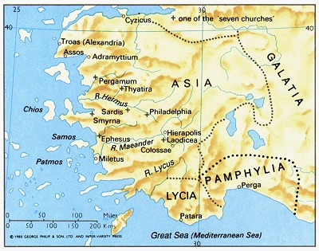
Ephesus was the capital of Asia
176

Slide 15
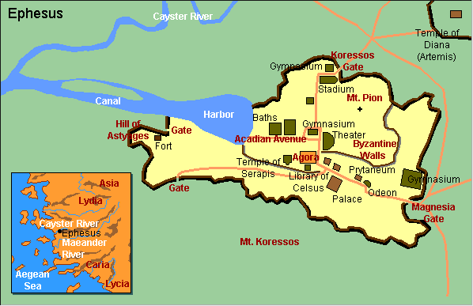
Ephesus City Layout

Slide 16
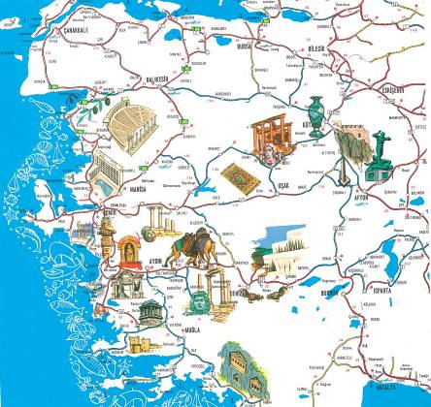
A Centre of Culture

Slide 17

Photo Album

Slide 18
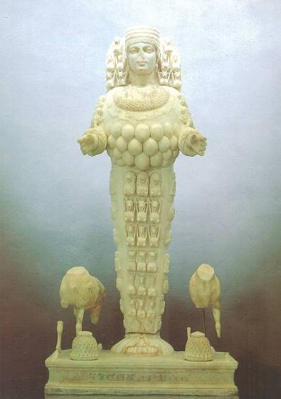
Artemis, Goddess of Fertility

Slide 19
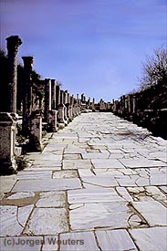
Marble Roads
Notes:
Marble city, chariot ruts, speed humps, after earthquake columns put back up again.

Slide 20
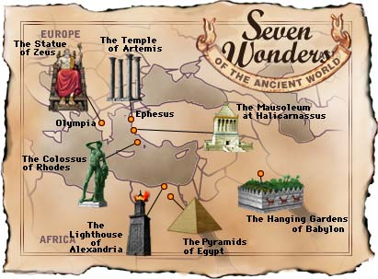
Seven Wonders of the Ancient World

Slide 21
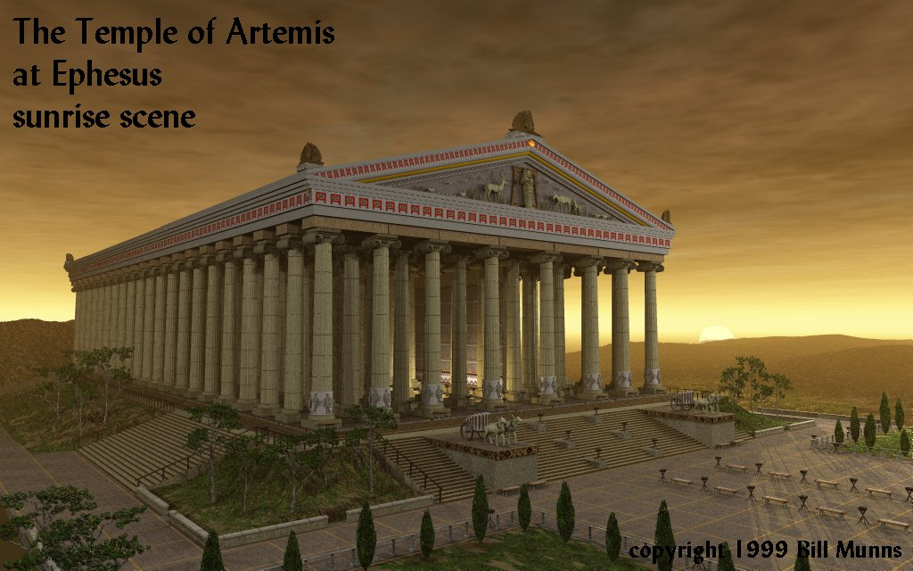
The Temple of Artemis at Ephesus
349
Notes:
Diana-the goddess mother of e/t, 127 Marble pillars, Artemis (Gk), Diana (Latin)

Slide 22
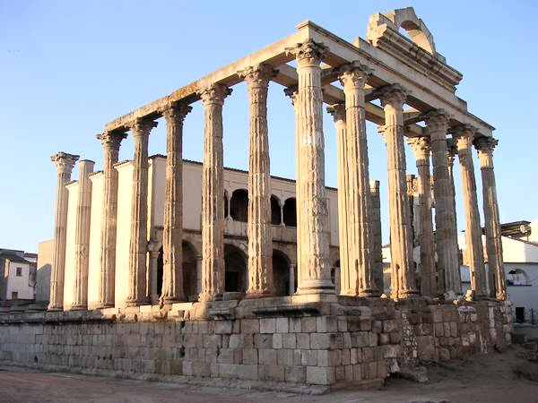
The Temple of Diana (Artemis) Today
349
Notes:
"In Roman mythology, Diana (lt. "heavenly" or "divine") was the goddess of the hunt and moon and birthing, being associated with wild animals and woodland, and having the power to talk to and control animals. She was equated with the Greek goddess Artemis, though she had an independent origin in Italy." (http://en.wikipedia.org/wiki/Diana_%28mythology%29)
Temple had 127 Marble pillars, Artemis (Gk), Diana (Latin)

Slide 23

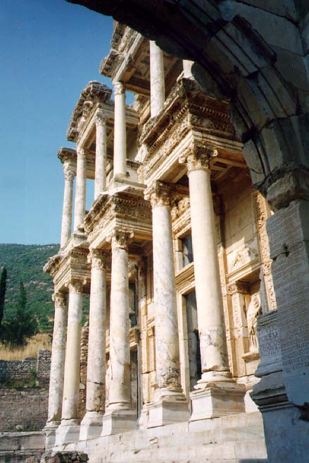
The Library of Caesar
349
Caesar
Notes:
Sid Caesar, Venerate: Bow to Caesar or die

Slide 24
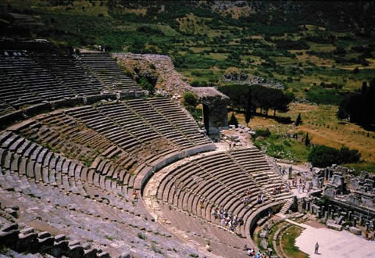
Theater Seats 25,000
theh'-at-ron
349
Acts 19:29
Notes:
The place where the Ephesian clerk averted a riot in Acts 19:29

Slide 25
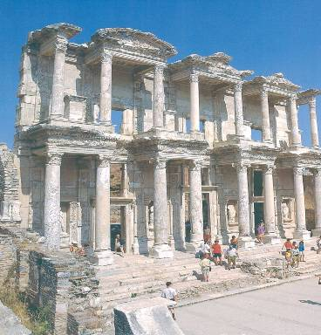
Library
349

Slide 26
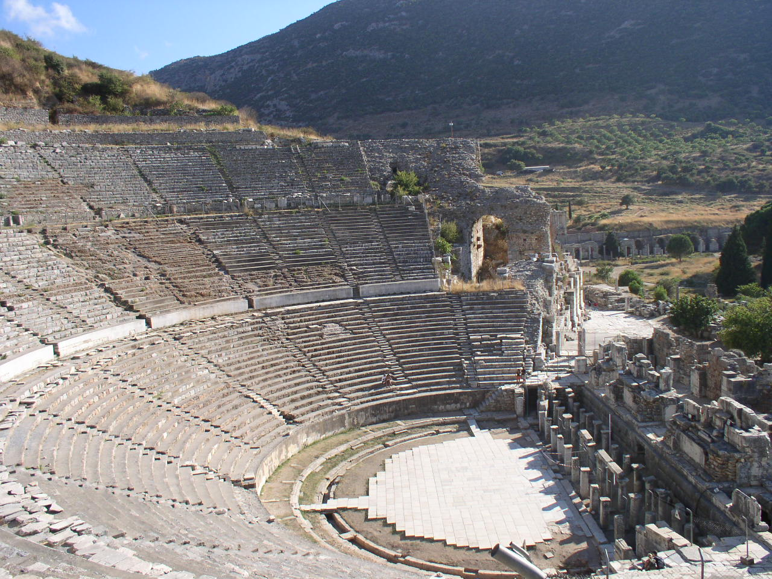
Amphitheatre
349

Slide 27
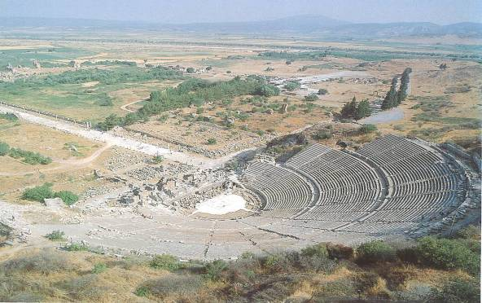
Arcadian Avenue
349

Slide 28
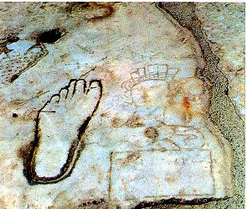
Directions for the Immoral & Illiterate
349

Slide 29
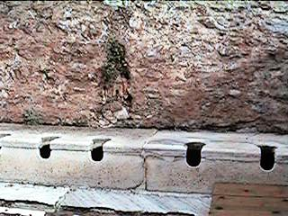
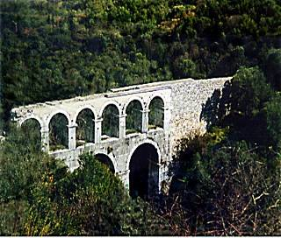
Toilets and aqueduct
349

Slide 30
Ephesus (Rev. 2:1-7)
349
Promise
You will eat from the tree of life
Pergamum
Warning
If you do not repent,
I will come to you and remove your lamp stand from its place
Thyatira
Exhortation
Remember
Repent
Return to the things you did at first
Rebuke
You have forsaken your first love
Commendation:
Deeds, hard work, perseverance
Intolerant of wicked, endure hardships, hates Nicolaitans
Christ:
7 stars in right hand, walks among lamp stands
Smyrna
Sardis
Ephesus
Philadelphia
Laodicea

Slide 31
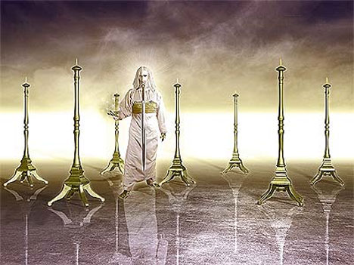
349
Hãy viết cho thiên sứ của Hội thánh Ê-phê-sô rằng: Nầy là lời phán của Đấng cầm bảy ngôi sao trong tay hữu và đi chính giữa bảy chơn đèn vàng: (2:1)

Slide 32

Book Chart of Ephesians
175

Slide 33
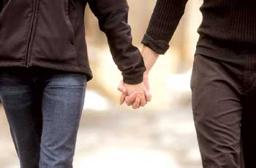
Khải huyền 2:4 (NIV)
Remember when you loved at first?
Yet I hold this against you:
You have forsaken
your first love.

Slide 34
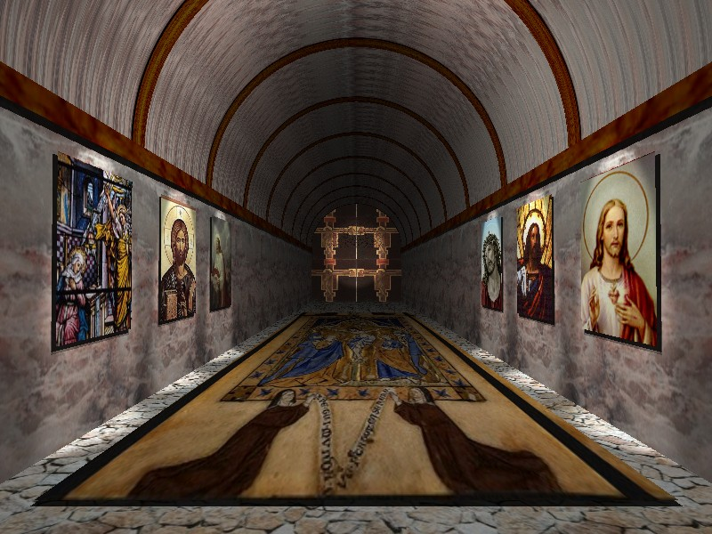
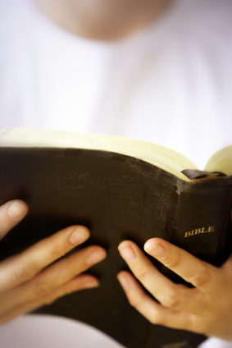
Khải huyền 2:4 (NIV)
Ephesus: Busy Yet Backslidden
Rev 2:4 Nhưng điều ta trách ngươi, là ngươi đã bỏ lòng kính mến ban đầu.

Slide 35
Black

Slide 36
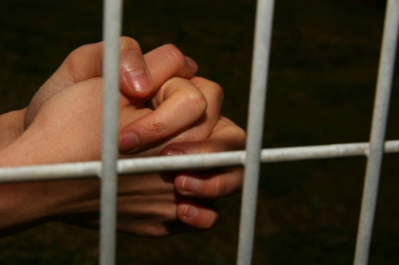
Suffering Yet Steadfast
The Church of Smyrna
(Rev. 2:8-11)
Rick Griffith • Crossroads International Church • biblestudydownloads.com

Slide 37
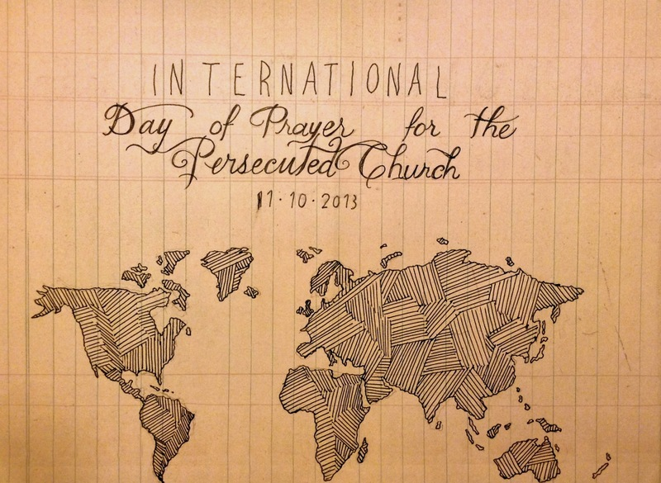
IDOP
International Day of Prayer for the Persecuted Church 11-10-2013
Notes:
Today and last Sunday, over one half million churches around the globe commemorate the International Day of Prayer for the Persecuted Church. We stand with them and have designed our entire service to remember our suffering brothers and sisters who lose property, livelihood, and loved ones—yes, who lose even life itself—simply due to their faith in our Lord Jesus Christ.

Slide 38
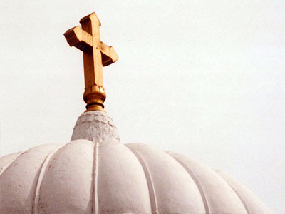
All-Saints Church
22 Sep 2013
Notes:
Our thoughts today turn to seven weeks ago from this day to All-Saints Church.

Slide 39
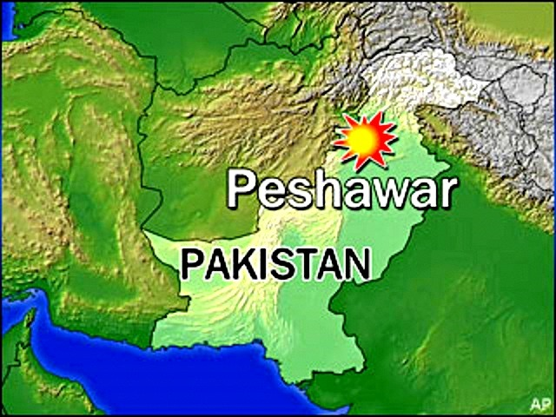
All-Saints Church
22 Sep 2013
Notes:
The church is located in the northern region of Pakistan in the city of Peshawar, close to the border with Afghanistan.

Slide 40
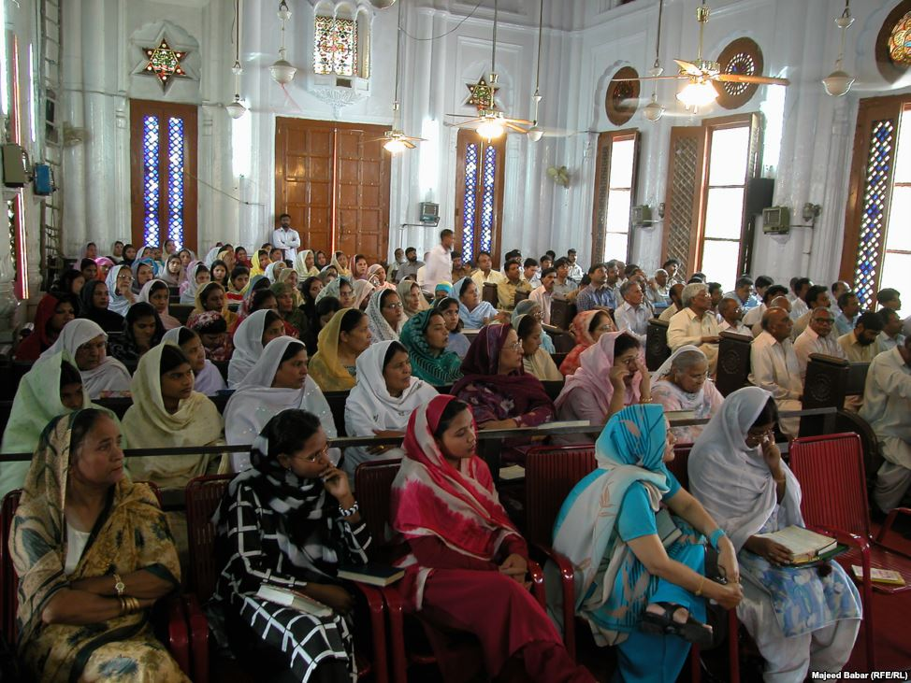
All-Saints Church
22 Sep 2013
Notes:
Inside the church it looks much like many others in that region where the men and the women sit on opposite sides.

Slide 41
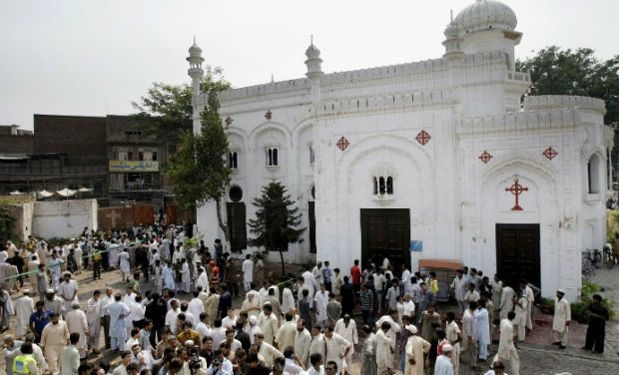
All-Saints Church
22 Sep 2013
Notes:
On 22 September 2013 after the service the believers gathered outside the building in the courtyard to talk, to eat—over 200 men, women, and children.

Slide 42
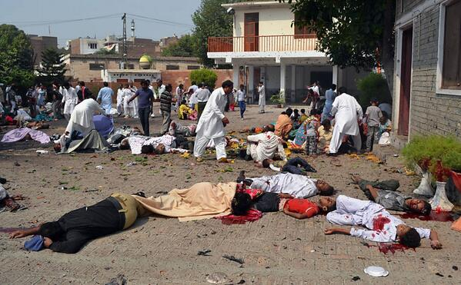
All-Saints Church
22 Sep 2013
Notes:
Infiltrating the crowd were two suicide bombers, who struck the All Saints Church members after their service that Sunday, killing more more than 90 people and wounding more than 150. The victims included many children.

Slide 43
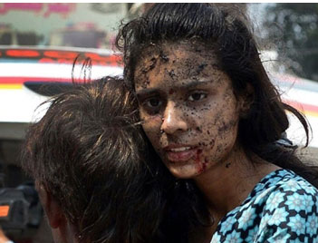
All-Saints Church
22 Sep 2013
Notes:
None of us can imagine the horror of that moment.

Slide 44
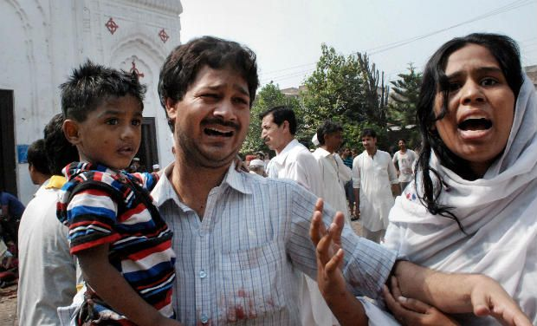
All-Saints Church
22 Sep 2013
Notes:
None of us can.

Slide 45
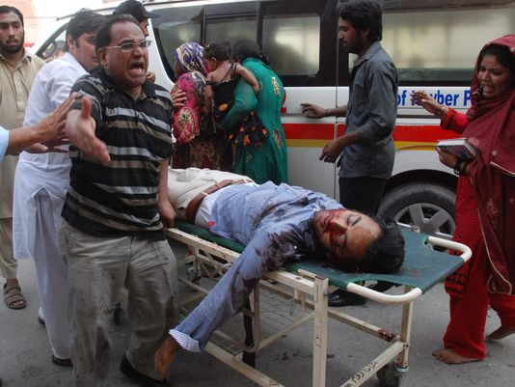
All-Saints Church
22 Sep 2013
Notes:
A wing of the Pakistani Taliban claimed responsibility for the bombing, saying it would continue to target non-Muslims until the United States stopped drone attacks in the country's remote tribal region.

Slide 46
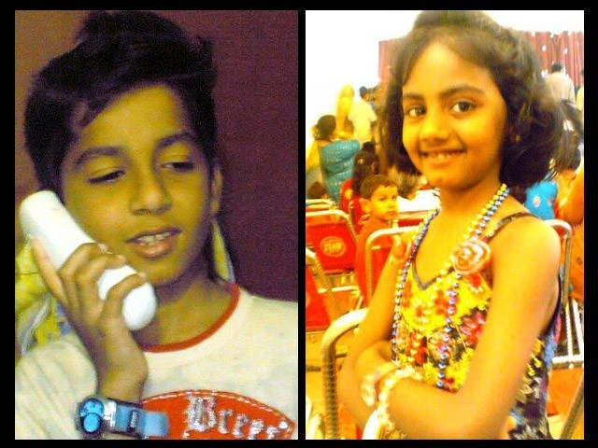
Eshaan & Neha
Notes:
The saddest part of the story concerns the children. The father of Eshaan and Neha was on business in the US at the time, but later wrote, "As he did after every Sunday mass, Eshaan was playing near the church gate with his friends. Little was he to know that this was the last time he would pray in church, play with his friends, tease his sister or hug his mother. His head was ripped off by the blast and his sister Neha, who was running after him at the time, was so traumatised by the sight that her little heart gave in and she collapsed next to Eshaan’s torn body."
Full article:
"The twin bombs that exploded on Sunday at All Saints Church, Peshawar, killed more than 90 people, injured nearly 150 others, and emotionally scarred thousands more.
Investigations are under way while recovery and treatment has begun for the injured and their families. For some, healing will be swift while others may take small steps over months, maybe even years. Many more might never fully recover from this tragedy.
The most heartbreaking of this and such tragedies is the number of young lives lost in these attacks. Since the blast took place on Sunday, the All Saints Church was packed to the brim with Christians from the locality; many of them students, volunteers, youth leaders, activists and Sunday school children. These were children we all knew, if not in person, at least by face. Even now as I close my eyes, I can visualise the happy little angels skipping through the church doors.
It is therefore, with great sorrow and a heavy heart that I share my memories of Neha and Eshaan.
Since the blast, I have not had a moment’s peace as I keep remembering how they used to make me laugh at their playful antics. Today I realised that the only way to alleviate my pain, even if a little bit, is by sharing their story.
These little victims of the senseless violence that rocked Peshawar in general and the Christian community in particular, were gems treasured by their parents, family, friends and teachers alike.
As he did after every Sunday mass, Eshaan was playing near the church gate with his friends. Little was he to know that this was the last time he would pray in church, play with his friends, tease his sister or hug his mother. His head was ripped off by the blast and his sister Neha, who was running after him at the time, was so traumatised by the sight that her little heart gave in and she collapsed next to Eshaan’s torn body.
I cannot even begin to imagine what Eshaan and Neha’s parents must be feeling right now. I can’t imagine the horror that any parent would feel upon hearing such news – that their two young children, the apples of their eyes, the stars in their life – are no more. There can be nothing more traumatic than raising your children, caring for them, loving them and already dreaming of their future only to have them ripped away from you.
In Eshaan and Neha’s case, the situation was worsened because their father, Insar, was in the United States at the time of the blast. In a cracked voice, he said over the phone,
“They were little angels sent down to me to love and protect. Like most fathers, I was often over-protective and sometimes downright clingy. After all, my children were my treasure.”
His voice completely broke then, and all we heard for a few minutes was the heart-wrenching weeping of a man in physical and emotional trauma. Mustering up his strength, he said,
“No parent should ever have to encounter a day like today; no parent should ever have to hear the words that your child is no more. Parents are never prepared to lose their children, not even children who have a terminal illness. Then how do I deal with something I did not even have an inkling of?”
After every few minutes of crying and talking about his children, he repeated, almost like a mantra,
“If only I was in Pakistan.”
While their father is in the US and has not been able to catch a flight back home yet, their mother, Uzma, is in the Intensive Care Unit (ICU). She still has no idea of what happened to her children.
Remembering his children, Insar says,
“Children change our life. They show us new ways to love, new things to find joy in, and new ways to look at the world.”
However, for Insar and Uzma the world has become dark and empty. This one incident has taken the light of their lives away and every room, every toy, every scribble will bring back painful memories. Their only wish will be to turn back time and see their children one last time, hold them tight and kiss their glowing faces. There will be times when getting through the day will feel like torture.
All we can do is pray that with time, these memories will become less painful and that one day, Insar and Uzma will begin to re-build their lives. We hope that they will learn to carry with them, happy memories of the love they shared with their precious children, even if it was for such a short time.
http://blogs.tribune.com.pk/story/18971/they-were-just-children-not-christian-children/

Slide 47
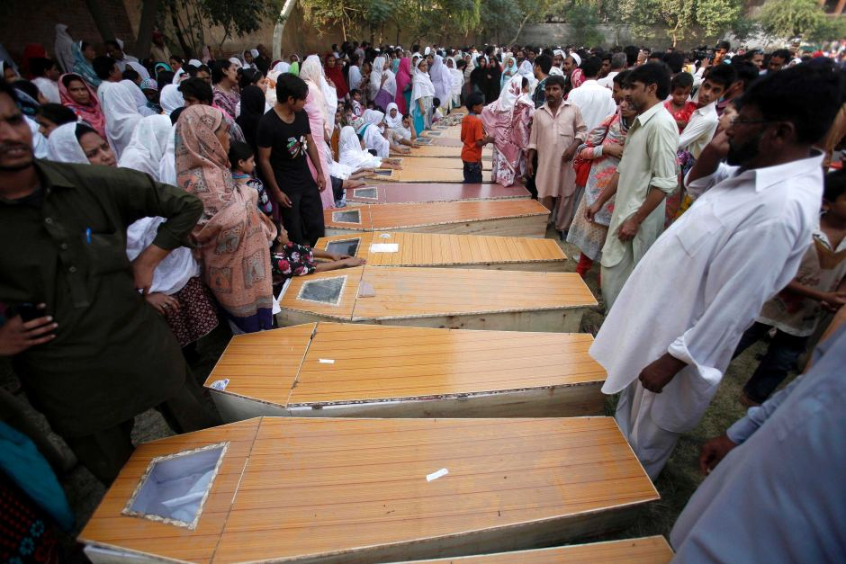
All-Saints Church
90 killed
150 wounded
13 widows
36 orphans
53 families lost bread winners
Notes:
The toll on a single assembly is staggering!

Slide 48
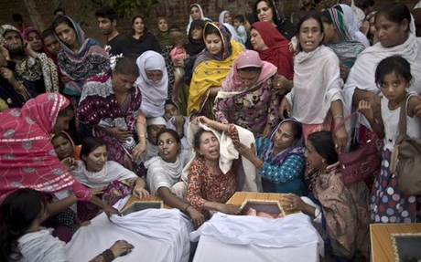
All-Saints Church
22 Sep 2013
Notes:
The grief is unimaginable.

Slide 49
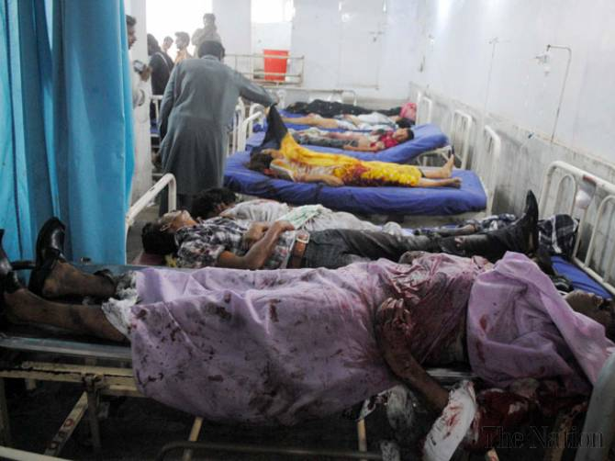
All-Saints Church
Doctors Absent
Notes:
The tragedy was compounded by the fact that the local hospital could not handle the crisis primarily because local doctors and paramedics refused to come to the hospital to treat the Christians—not until the local political leader ordered them to come or their jobs would be on the line.
Full article:
PESHAWAR - Death toll from Sunday’s twin bombings at All Saints Church was horrendous and Lady Reading Hospital was running out of caskets, beds and medicine for the wounded; and on top of that doctors and paramedics were absent.
To give vent to their anger over sorry state of affairs at the public health centre, attendants of the injured ransacked the hospital and chanted slogans against Khyber Pakhtunkhwa government for its inability to ensure every sort of health facility during the emergency situation.
Insufficient number of doctors and nurses was present at the hospital that could hardly provide first aid treatment to over 100 injured ferried from the blast site. Despite the fact that an emergency was declared, most of the doctors remained absent from their duties.
It came as a shock to learn that a provincial government so willing to provide free of cost treatment and medicines slipped on ensuring hassle-free health services. As a result, most of the injured could not get medical aid in a timely manner, while many of the injured had to lie down across the floor due to shortage of beds.
Nevertheless, when Pakistan Tehreek-e-Insaf chief Imran Khan came in, most of the doctors had to pull up their socks in order to save their skin.
People from different walks of life criticised PTI-led provincial government for its poor performance and asked it to provide all sort of health facilities to the injured. They also demanded stern action against the negligent doctors.
http://www.nation.com.pk/pakistan-news-newspaper-daily-english-online/national/23-Sep-2013/peshawar-hospital-ransacked-for-absence-of-docs-facilities

Slide 50
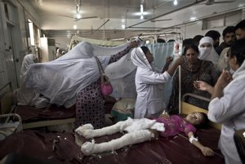
All-Saints Church
22 Sep 2013
Notes:
So they did, but it was too late for some of the victims who needed immediate care to save their lives.

Slide 51
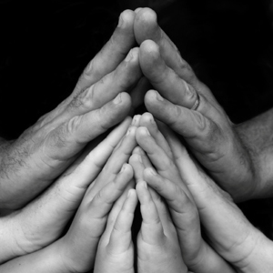
In what area are you "taking hits" for your faith in Christ?
Notes:
You workplace passes you up for promotion.
Your motives are misunderstood.
You are lumped with fanatics.
Your faith is ridiculed in your family.
Some other area?

Slide 52
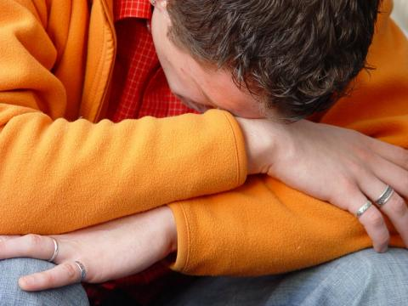
How does Jesus want you to respond to suffering?
Notes:
What is most important is Christ's view of suffering—how he wants us to address it!

Slide 53
Christ's Writing Ministry
Notes:
We have NO actual accounts of Jesus writing anything except what he wrote in the sand in John 8—and we have no idea what he wrote!

Slide 54
If Jesus wrote a letter to our church, what would Jesus say?
R
Khải huyền
Notes:
We speak of WWJD (What Would Jesus Do)
However, I am addressing WWJS

Slide 55
Asia Minor in AD 95
345
Adramyttium
Aezani
Cyme
Erythrae
Eumenia
Lebedus
Colophon
Nysa
Hierapolis
Trailes
Heraclea
Aphrodisias
Colossae
Alabanda
Patmos
Miletus
Notes:
In AD 95 John was exiled to the lonely island of Patmos out in the Adriatic Sea. Jesus Christ had a Khải huyền of comfort to the suffering believers of Asia Minor, but how could this message reach them?

Slide 56
The 7 Churches (Rev. 2–3)
345
Adramyttium
Aezani
Pergamum
Thyatira
Cyme
Erythrae
Sardis
Smyrna
Eumenia
Philadelphia
Lebedus
Colophon
Ephesus
Nysa
Laodicea
Hierapolis
Trailes
Heraclea
Aphrodisias
Colossae
Alabanda
Patmos
Miletus
Notes:
Jesus designed a brilliant strategy by having his Khải huyền sent to capital of the province, Ephesus. It included an individual letter to Ephesus, as well as letters to 6 other key churches. The Ephesians copied the entire book of Khải huyền, though, and sent the original to the next city, Smyrna. Smyrna then made their own copy and sent the original to Pergamum, which lay on the main road to the north. This city then sent the prophecy to Thyatira, which sent it to Sardis, then Philadelphia, and finally to Laodicea.

Slide 57
The 7 Churches (Rev. 2–3)
345
Pergamum
Thyatira
Sardis
Smyrna
Philadelphia
Ephesus
Laodicea
Notes:
These 7 churches were neither the largest, nor the most influential cities in Asia Minor. However, they were strategically located on a key highway that linked them all.
[Animate} From their own locations we understand that they also copied the prophecy and sent these copies to other churches near them.

Slide 58
What are the 7 Stars & 7 Lampstands (1:20 NLT)?
Rev 1:20 tức là sự mầu nhiệm của bảy ngôi sao mà ngươi thấy trong tay hữu ta, và của bảy chơn đèn vàng. Bảy ngôi sao là các thiên sứ của bảy Hội thánh, còn bảy chơn đèn là bảy Hội thánh vậy.

Slide 59
Christ has authority over all churches
344
Notes:
The point of Khải huyền 2–3 is that Jesus has authority over all churches

Slide 60
So Jesus wrote 7 churches (Rev. 2–3)
Ephesus
Smyrna
Pergamum
Thyatira
Sardis
Philadelphia
Laodicea

Slide 61
Khải huyền
Sovereignty of Christ in Future Victory
Sovereignty in His Person |  |  | Sovereignty over Churches | Sovereignty in End-Time Events
Chapter 1 |  |  | Chapters 2–3 | Chapters 4–22
"What you have seen" (1:19a) |  |  | "What is now" (1:19b) | "What will take place later" (1:19c)
Past |  |  | Present | Future
Christ Unveiled |  |  | Churches Unveiled | Consummation Unveiled
God on Earth |  |  | God's Ambassadors on Earth | Hell on Earth to Heaven on Earth
The Judge |  |  | The Assignments | The Judgments & Rewards
Subject 1:1-3 | Worship of Trinity 1:4-8 | Glorified Christ 1:9-20 | Seven Churches of Asia: Ephesus Smyrna Pergamum Thyatira Sardis Philadelphia Laodicea | Tribulation 4:1–19:10 | Second Coming 19:11-21 | Millennium 20 | Eternal State 21:1–22:5 | Closing: Imminency 22:6-21
AD 95
318, 324 M
Notes:
These three chapters comprise the middle section of the book of Khải huyền in the sense in which John was to record "what he had seen" (1:19a, shown in the chapter 1 vision of Christ), followed by "what is now" (1:19b), or what was happening at the present time around AD 95 among these churches of Asia, in modern-day western Turkey.

Slide 62
The 7 Churches (Rev. 2–3)
Promise
348
Pergamum
Warning
Thyatira
Exhortation
Rebuke
Commendation
Smyrna
Sardis
N/A
Christ
N/A
N/A
N/A
Ephesus
Philadelphia
N/A
Laodicea
Notes:
Though some exceptions exist (noted with “N/A” above), the basic pattern of the seven letters is a sevenfold outline:
Church name
Christ Described in a Unique Way for that Church
Commendation of Good Deeds among the Believers
Rebuke of Sin within the Church
Exhortation or Encouragement to Repent
Warning if the Exhortation is Disobeyed or a warning to prepare them for difficulties
Promise for Faithfulness
Notice also that each letter not only begins with a reference to Christ but ends with an appeal from the Spirit.

Slide 63
Ephesus was the capital of Asia
176
Notes:
The first letter was sent to Ephesus, which we covered last week.

Slide 64
Khải huyền 2:4 (NIV)
Ephesus: Busy Yet Backslidden
Nhưng điều ta trách ngươi, là ngươi đã bỏ lòng kính mến ban đầu.
Notes:
Despite the many things the Ephesian church did right in their service for Christ, they were "busy but backslidden."

Slide 65
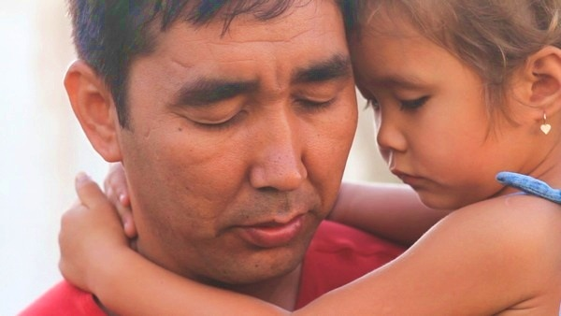
How can we handle suffering?
Christ gave Smyrna three ways.
Notes:
So today we come to the second letter, written to believers in Smyrna. This letter addresses this question…

Slide 66
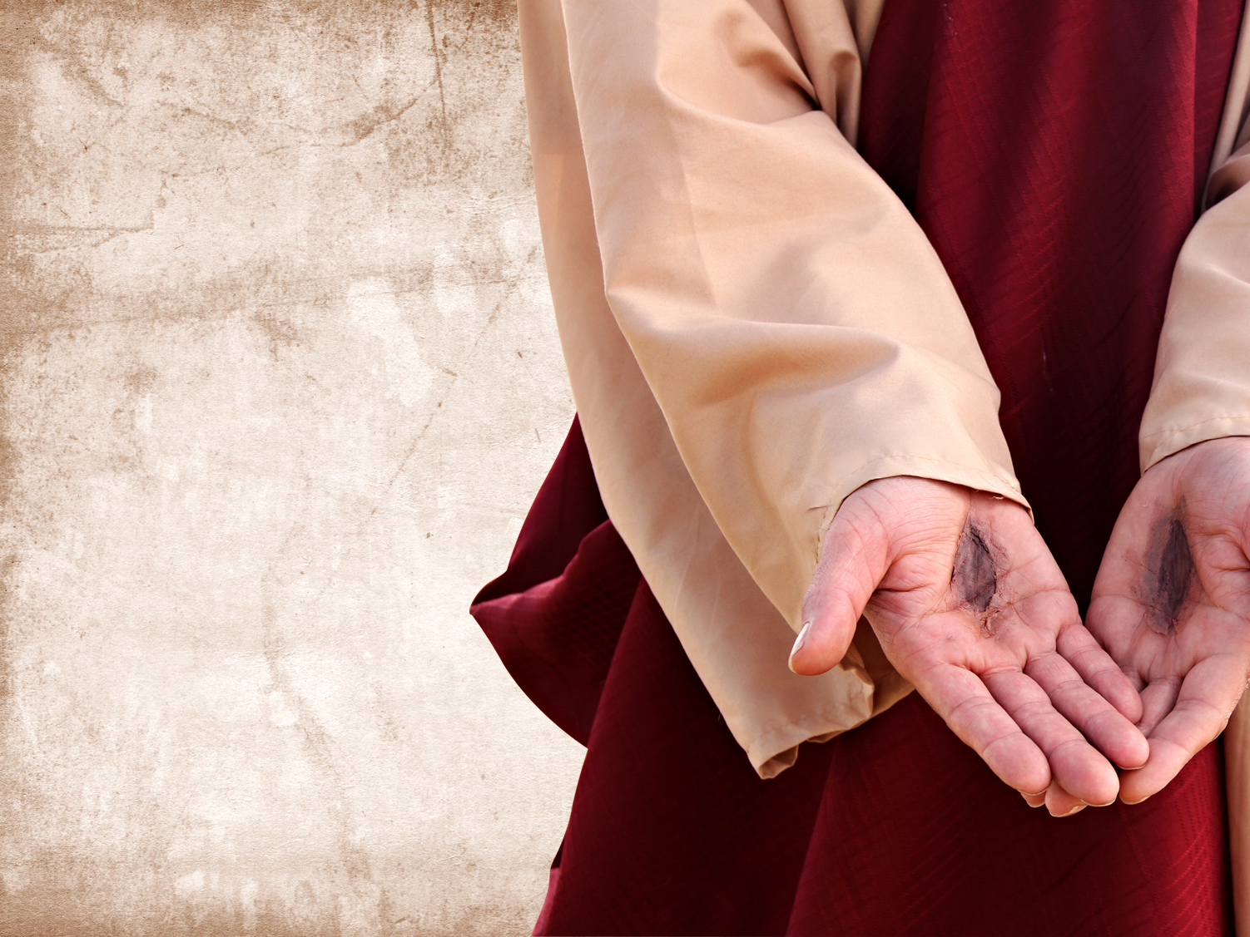
I. Recognize that Christ understands your suffering (2:8-9)
Notes:
Know that Jesus has "been there, done that."

Slide 67
The 7 Churches (Rev. 2–3)
345
Adramyttium
Aezani
Pergamum
Thyatira
Cyme
Erythrae
Sardis
Smyrna
Eumenia
Philadelphia
Lebedus
Colophon
Ephesus
Nysa
Laodicea
Hierapolis
Trailes
Heraclea
Aphrodisias
Colossae
Alabanda
Patmos
Miletus
Notes:
Smyrna was a seaport city like Ephesus, about 35 miles north. It still exists today with the name of Izmir.

Slide 68
Smyrna (Rev. 2:8-11)
351
Pergamum
Thyatira
Rebuke
None!
Commendation:
Suffers persecution
and poverty
Christ:
The First and the Last, who died and came to life again
Smyrna
Sardis
Ephesus
Philadelphia
Laodicea

Slide 69
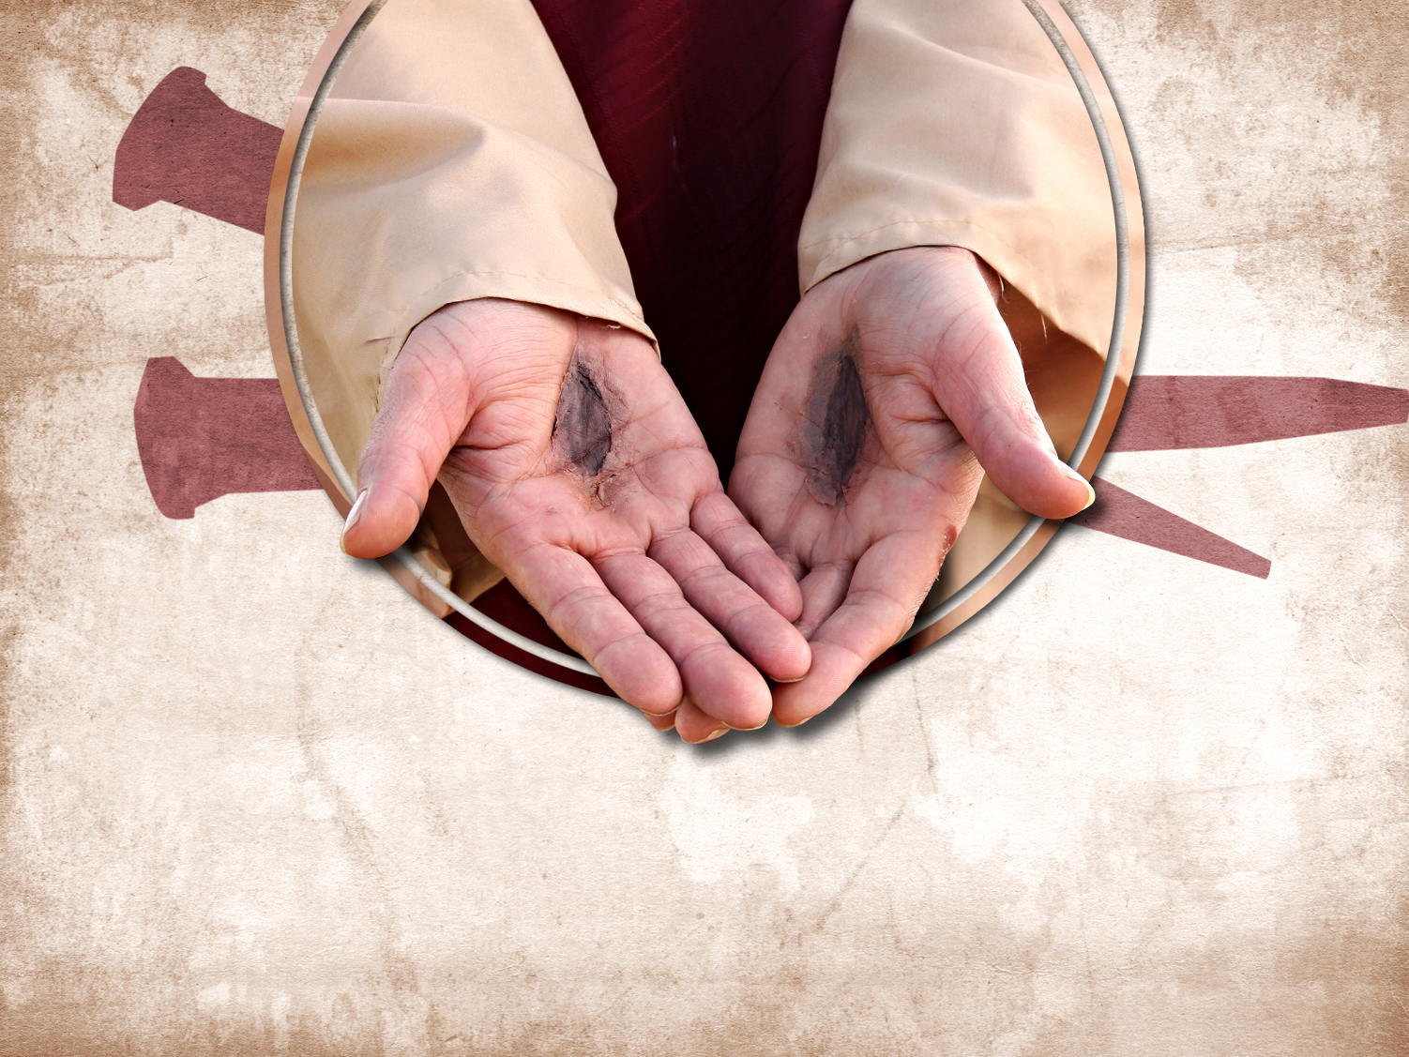
Thank Christ that he understands your own area of suffering

Slide 70
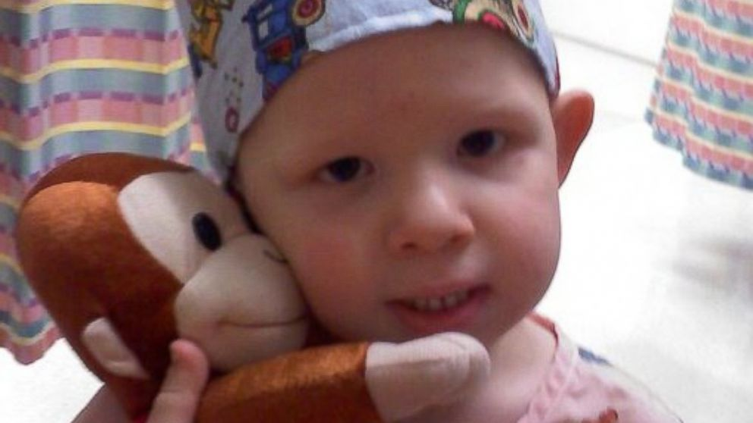
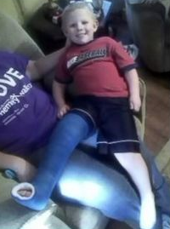
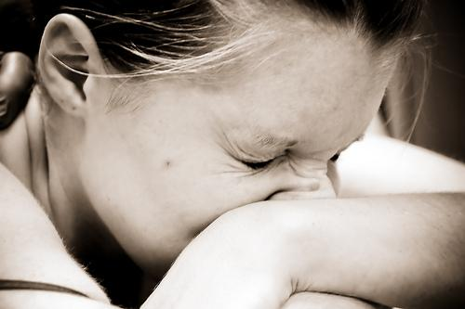
Isaac Brown
The Boy Who Feels NO Pain
http://abcnews.go.com/Health/meet-toddler-feels-pain/story?id=20658484
Notes:
Is pain good? Most of us do not think so!
• Isaac
Little Isaac Brown is five years old. Like other kids his age, he's learning to read and write his ABCs and to calculate simple addition and subtraction. But there is one thing Isaac is learning that rare few other children will ever have to learn. Isaac is learning about pain.
"We're doing the best we can to just teach him; he knows blood is bad," said Brown. "We taught him even when he was little to say 'ow.' You don't have to tell normal kids to say 'ow.'"
• Baby
Isaac was born with an extremely rare genetic insensitivity to pain. Like a modern day leper, Isaac doesn't know when he's touching a hot stove, when he's stepped on broken glass, or when he's broken a bone. For example, he broke his pelvis and felt no pain at all.
• Leg
Because he doesn't feel injuries, Isaac's parents, Carrie and Randy Brown, are teaching him how to identify them to stay healthy.

Slide 71

Isaac Brown
The Boy Who Feels NO Pain
"When he was diagnosed, [doctors said] there's nothing we can do for Isaac, not yet anyway," [his mother] Carrie recalled. "But the fact that they can take his mutated gene and cause people with chronic pain to feel less pain. The thought of that is unreal…. God gave us Isaac, maybe for this very purpose."
http://www.medicaldaily.com/can-boy-who-feels-no-pain-help-chronic-pain-sufferers-261005
Notes:
Family
"The toddler years were an absolute nightmare," said Isaac's mother, Carrie Brown. "He would just drop to the ground and smack his face on the table. He thought the fall was fun."
Isaac has dunked his hand in hot coffee without flinching. He once placed his palm on a working oven burner without shedding a tear.
His parents are believers. His mother noted..
Read quote

Slide 72
Reasons for Suffering
John Walvoord, "Khải huyền," in The Bible Knowledge Commentary, 2:935
      “Suffering can be expected for the ungodly, but why should the godly suffer? The Scriptures give a number of reasons. Suffering may be:
        disciplinary (1 Cor. 11:30-32; Heb. 12:3-13),
        preventive (as Paul’s thorn in the flesh, 2 Cor. 12:7),
        the learning of obedience (as Christ’s suffering, Heb. 5:8; cf. Rom. 5:3-5), or
        the providing of a better testimony for Christ (as in Acts 9:16).”

Slide 73

Christ feels your pain.

Slide 74
I. Recognize that Christ understands your suffering (2:8-9)

Slide 75

II. Don't fear suffering for Christ (2:10a)
Notes:
During Nero's persecutions Christians refused to stop worshipping Christ, so they held their services underground in the tombs beneath Rome.

Slide 76
Smyrna (Rev. 2:8-11)
351
Pergamum
Thyatira
Exhortation
Do not be afraid.
Rebuke
None!
Commendation:
Suffers persecution
and poverty
Christ:
The First and the Last, who died and came to life again
Smyrna
Sardis
Ephesus
Philadelphia
Laodicea

Slide 77

Who fears more?
Persecutors?
Persecuted?
"Do not fear what they [persecutors] fear…"
(1 Peter 3:14b)

Slide 78

Giving
13:3 Dầu tôi phân phát gia tài để nuôi kẻ nghèo khó, lại bỏ thân mình để chịu đốt, song không có tình yêu thương, thì điều đó chẳng ích chi cho tôi.
"The Blood of the Martyrs is the seed of the Church"
-Tertullian-

Slide 79

All-Saints Church
Responses
Dedicated to the Martyrs of All Saints Church Peshawar Blast
No one can move them, neither can they tremble

Slide 80

All-Saints Church
Sometimes we react based on fear

Slide 81

Indian Christians Call to End Relations with Pakistan
Political Responses
Notes:
Indian Christians burn Pakistan’s flag to protest church attack in Peshawar - See more at: http://post.jagran.com/christians-burn-pakistans-flag-to-protest-church-attack-in-peshawar-1380097718#sthash.drVPwCB0.dpuf

Slide 82

All-Saints Church
Responses of Anger

Slide 83

All-Saints Church
22 Sep 2013
Notes:
Note the large words in English that the people of All Saints read prior to their martyrdom or suffering in the courtyard

Slide 84

Our Response
If one part suffers…
Notes:
We have committed S$3000 to help 6 families who lost their bread winners for three months.

Slide 85

Will you confess your fear of suffering right now?

Slide 86
I. Recognize that Christ understands your suffering (2:8-9)

Slide 87
II. Don't fear suffering for Christ (2:10a)
Notes:
During Nero's persecutions Christians refused to stop worshipping Christ, so they held their services underground in the tombs beneath Rome.

Slide 88

III. Be faithful during suffering (2:10b-11).
Notes:
Commit now not to waver or give up your faith due to persecution.

Slide 89
Smyrna (Rev. 2:8-11)
351
Warning
The devil will throw some of you into prison and you will suffer for 10 days
Thyatira
Pergamum
Exhortation
Do not be afraid.
Be faithful, even to the point of death
Rebuke
None!
Commendation:
Suffers persecution
and poverty
Christ:
The First and the Last, who died and came to life again
Smyrna
Sardis
Ephesus
Philadelphia
Laodicea

Slide 90

Smyrna: Suffering Yet Steadfast
"The devil will throw some of you into prison and test you for 10 days" (2:10b)

Slide 91
Smyrna (Rev. 2:8-11)
351
Pergamum
Thyatira
Exhortation
Do not be afraid.
Be faithful, even to the point of death
Rebuke
None!
Commendation:
Suffers persecution
and poverty
Christ:
The First and the Last, who died and came to life again
Smyrna
Sardis
Ephesus
Philadelphia
Laodicea

Slide 92

“Be faithful until death” (2:10c)

Slide 93

Perpetua's Martyrdom (AD 203)
352
Notes:
She refused to offer incense to Diana's image and thus was killed for it.

Slide 94
Smyrna (Rev. 2:8-11)
351
Promise
Will receive a crown of life
Warning
The devil will throw some of you into prison and you will suffer for 10 days
Thyatira
Pergamum
Exhortation
Do not be afraid.
Be faithful, even to the point of death
Rebuke
None!
Commendation:
Suffers persecution
and poverty
Christ:
The First and the Last, who died and came to life again
Smyrna
Sardis
Ephesus
Philadelphia
Laodicea

Slide 95

ENDA
How the issue is framed…
DEFEND EQUALITY
Employment
Non-
Discrimination
Act
Notes:
ENDA has been presented in the two houses of the US Congress several times in the past 40 years, each time being defeated. However, the margin of defeat is narrowing and proponents are at it again.

Slide 96

ENDA
How the issue is framed…
END(A) LEGAL
DISCRIMINATION!

Slide 97

ENDA
How the issue is framed…
I SHOWER NEXT TO A GAY PERSON. YOU CAN WORK NEXT TO ONE.
PASS ENDA.

Slide 98

Most Christian conservatives oppose ENDA
STOP
THE ENDA BILL

Slide 99

Previous ENDA Exceptions
How the issue is framed…
http://www.washingtonblade.com/2013/10/30/enda-heats/
"America's Leading Gay News Source"
"Currently (30 Oct 2013), ENDA has a religious exemption that provides leeway for religious organizations, like churches or religious schools, to discriminate against LGBT employees. That same leeway isn’t found under Title VII of the Civil Rights Act of 1964, which prohibits religious organizations from discriminating on the basis of race, gender or national origin."
Notes:
Supporters have convinced people that homosexuality is not only OK, but it MUST be supported as it is as unchangeable as one’s race, gender, or national origin.
http://www.washingtonblade.com/2013/10/30/enda-heats/

Slide 100

ENDA Actual Wording
"It shall be unlawful for any employer to fail or refuse to hire or to discharge any individual, or otherwise discriminate against any individual with respect to the compensation, terms, conditions, or privileges of employment of the individual, because of such individual's actual or perceived sexual orientation or gender identity."

Slide 101

ENDA Senate Vote (5 Nov 13)
"By a 61-30 margin, the Senate cleared the last hurdle between the Employment Non-Discrimination Act (ENDA) and final passage before heading to the House. Unlike dozens of other versions, this bill takes the radical agenda a step farther by including 'gender identity' as a protected class under the law. According to 61 U.S. Senators, American schools, organizations, companies, and charities would have to swallow their concerns about safety, profits, and future business and not only encourage men to dress like women (and vice-versa) at work — but make special accommodations for them to do so."
Tony Perkins' Washington Update Family Research Council 6 Nov 2013

Slide 102

House of Representatives
Speaker John Boehner Opposes ENDA
"The Speaker believes this legislation will increase frivolous litigation and cost American jobs, especially small business jobs." Boehner, his office continued, has "always believed this is covered by existing law."
Tony Perkins' Washington Update Family Research Council 7 Nov 2013

Slide 103

Main Idea
Replace fear with faithfulness during suffering since Jesus knows exactly how you feel
Are you ready?

Slide 104

How are you suffering now?
      Recognize that Jesus understands your situation.
      Don’t fear suffering for Christ in this area.
      Be faithful to him despite the outcome.

Slide 105
Black

Slide 106
INDIA
352
Dầu tôi phân phát gia tài để nuôi kẻ nghèo khó, lại bỏ thân mình để chịu đốt, song không có tình yêu thương, thì điều đó chẳng ích chi cho tôi
1 Co. 13:3
"The Blood of the Martyrs is the seed of the Church"
-Tertullian-

Slide 107

The Burnt Church Building
352

Slide 108

A fire destroyed this church building
352

Slide 109

Some Christians Survived
352

Slide 110

Others went to Jesus
352

Slide 111
Black

Slide 112
Dear Pergamum,
The Compromising Yet Continuing Church

Slide 113
Pergamum (Rev. 2:12-17)
353
Promise
Will receive hidden manna and white stone with a new name on it
Pergamum
Warning
If you do not repent,
I will make war against those people with the sword of my mouth
Thyatira
Exhortation
Repent!
Rebuke
People there hold the teachings of Balaam and of the Nicolaitans
Commendation:
Remains true to Christ; does not renounce her faith
Christ:
Has the sharp, double-edged sword
Smyrna
Sardis
Ephesus
Philadelphia
Laodicea

Slide 114
Khải huyền 2:12-17
Ai có tai, hãy nghe lời Đức Thánh Linh phán cùng các Hội thánh rằng: Kẻ nào thắng, sẽ chẳng bị hại gì về lần chết thứ hai.
2:12 Cùng hãy viết cho thiên sứ của Hội thánh Bẹt-găm rằng: Nầy là lời phán của Đấng có thanh gươm nhọn hai lưỡi:
2:13 Ta biết nơi ngươi ở; đó là ngôi của quỉ Sa-tan; ngươi đã vững lòng tôn danh ta, không chối đạo ta; dầu trong những ngày đó, An-ti-ba, kẻ làm chứng trung thành của ta đã bị giết nơi các ngươi, là nơi Sa-tan ở.
2:14 Nhưng ta có điều quở trách ngươi; vì tại đó, ngươi có kẻ theo đạo Ba-la-am, người ấy dạy Ba-lác đặt hòn đá ngăn trở trước mặt con cái Y-sơ-ra-ên, đặng dỗ chúng nó ăn thịt cúng thần tượng và rủ ren làm điều dâm loạn.
2:15 Ngươi lại cũng có những kẻ theo đạo Ni-cô-la.
2:16 Vậy, hãy ăn năn đi, bằng chẳng, ta sẽ đến mau kíp cùng ngươi, lấy thanh gươm ở miệng ta mà giao chiến cùng chúng nó.
2:17 Ai có tai, hãy nghe lời Đức Thánh Linh phán cùng các Hội thánh: Kẻ nào thắng, ta sẽ ban cho ma-na đương giấu kín; và ta sẽ cho nó hòn sỏi thắng, trên đó có viết một tên mới, ngoài kẻ nhận lấy không ai biết đến.

Slide 115
Christ's Commission
Cùng hãy viết cho thiên sứ của Hội thánh Bẹt-găm rằng: Nầy là lời phán của Đấng có thanh gươm nhọn hai lưỡi: (2:12)

Slide 116
Christ's Commendation
Rev 2:13 Ta biết nơi ngươi ở; đó là ngôi của quỉ Sa-tan; ngươi đã vững lòng tôn danh ta, không chối đạo ta; dầu trong những ngày đó, An-ti-ba, kẻ làm chứng trung thành của ta đã bị giết nơi các ngươi, là nơi Sa-tan ở.

Slide 117

Model of Pergamum:
Continuing Yet Compromising
353
Notes:
It has long been assumed that the temple was dedicated to Zeus. The altar is mentioned in the Book of Khải huyền, 2:11-12: "To the angel of the church in Pergamum, write this: . . . 'I know that you live where Satan's throne is . . . . '" This is a scale model of the altar.

Slide 118

Altar of Zeus
353
"I know where you live—where Satan has his throne" (2:13)
Notes:
It has long been assumed that the temple was dedicated to Zeus. The altar is mentioned in the Book of Khải huyền, 2:11-12: "To the angel of the church in Pergamum, write this: . . . 'I know that you live where Satan's throne is . . . . '" This is a scale model of the altar.

Slide 119
Christ's Condemnation
Rev 2:14 Nhưng ta có điều quở trách ngươi; vì tại đó, ngươi có kẻ theo đạo Ba-la-am, người ấy dạy Ba-lác đặt hòn đá ngăn trở trước mặt con cái Y-sơ-ra-ên, đặng dỗ chúng nó ăn thịt cúng thần tượng và rủ ren làm điều dâm loạn.

Slide 120
Some of their members held to the doctrine of Balaam
Rev 2:14 Nhưng ta có điều quở trách ngươi; vì tại đó, ngươi có kẻ theo đạo Ba-la-am, người ấy dạy Ba-lác đặt hòn đá ngăn trở trước mặt con cái Y-sơ-ra-ên, đặng dỗ chúng nó ăn thịt cúng thần tượng và rủ ren làm điều dâm loạn.

Slide 121

Numbers
354
Preparation to Occupy the Land
Preparing the
Old Generation
Postponement
for Unbelief
Preparing the
New Generation
1:1–10:10
10:11–25:18
26–36
God's Faithfulness
Israel's Faithlessness
God's Faithfulness
God's Blessings
God's Discipline
God's Blessings
Israel's Commitment
Israel's Complaining
Israel's Commitment
Order
Disorder
Reorder
Mount Sinai
Wilderness
Moab
20 Days
38 Years, 3 Months, 10 Days
ca. 5 Months
Organization
(1-4)
Sanctification (5:1-10:10)
To Kadesh (10:11-
12:16)
Kadesh Sin
(13-14)
Wilder-ness (15-19)
To Moab (20-21)
Moab
Sin
(22-25)
Provision for Land (26-27)
Offerings & Vows (28-30)
Final Preparations (31-36)

Slide 122

Transjordan Events
OTS 140
Victory over Sihon and Og (Num. 21)
Balak fails to turn God against Israel–blessing by Balaam (Num. 22-24)

Slide 123


Balaam
354
Balaam Numbers 22–24

Slide 124
Rev 2:14 Nhưng ta có điều quở trách ngươi; vì tại đó, ngươi có kẻ theo đạo Ba-la-am, người ấy dạy Ba-lác đặt hòn đá ngăn trở trước mặt con cái Y-sơ-ra-ên, đặng dỗ chúng nó ăn thịt cúng thần tượng và rủ ren làm điều dâm loạn.
Rev 2:15 Ngươi lại cũng có những kẻ theo đạo Ni-cô-la.
354

Slide 125
354
1Pe 2:15 Vì anh em làm điều lành để ngăn miệng những kẻ ngu muội dại dột, ấy là ý muốn của Đức Chúa Trời.
1Pe 2:16 Hãy ăn ở như người tự do, nhưng chớ dùng tự do làm cái màn che sự hung ác, song phải coi mình là tôi mọi Đức Chúa Trời.

Slide 126
Jude 11 (NIV)
354
Jud 1:11 Khốn nạn thay cho chúng nó, vì đã theo đường của Ca-in, lấy lòng tham lợi mà gieo mình vào sự sai lạc của Ba-la-am; và bị hư mất về s+¦ phản nghịch của Cơ-rê.

Slide 127
Transjordan Events
OTS 140
Victory over Sihon and Og (Num. 21)
Balak fails to turn God against Israel–blessing by Balaam (Num. 22-24)
Balak succeeds to turn Israel against God by immorality at Beth Peor (Num. 25)

Slide 128
Some of their members held to the doctrine of the Nicolaitans
Rev 2:15 Ngươi lại cũng có những kẻ theo đạo Ni-cô-la.

Slide 129
Christ's Correction
Rev 2:16 Vậy, hãy ăn năn đi, bằng chẳng, ta sẽ đến mau kíp cùng ngươi, lấy thanh gươm ở miệng ta mà giao chiến cùng chúng nó.

Slide 130
Repent...
Rev 2:16 Vậy, hãy ăn năn đi, bằng chẳng, ta sẽ đến mau kíp cùng ngươi, lấy thanh gươm ở miệng ta mà giao chiến cùng chúng nó.

Slide 131
Receive…
Rev 2:17 Ai có tai, hãy nghe lời Đức Thánh Linh phán cùng các Hội thánh: Kẻ nào thắng, ta sẽ ban cho ma-na đương giấu kín; và ta sẽ cho nó hòn sỏi thắng, trên đó có viết một tên mới, ngoài kẻ nhận lấy không ai biết đến.

Slide 132
Receive… The Bread of Life
Ai có tai, hãy nghe lời Đức Thánh Linh phán cùng các Hội thánh: Kẻ nào thắng, ta sẽ ban cho ma-na đương giấu kín; và ta sẽ cho nó hòn sỏi thắng, trên đó có viết
(2:17a)

Slide 133
Joh 6:30-35
Joh 6:30 Chúng bèn nói rằng: Thế thì thầy làm phép lạ gì, để cho chúng tôi thấy và tin? Thầy làm công việc gì?
Joh 6:31 Tổ phụ chúng ta đã ăn ma-na trong đồng vắng, theo như lời chép rằng: Ngài đã ban cho họ ăn bánh từ trên trời xuống.
Joh 6:32 Đức Chúa Jêsus đáp rằng: Quả thật, quả thật, ta nói cùng các ngươi, Môi-se chưa hề cho các ngươi bánh từ trên trời đâu; nhưng Cha ta ban cho các ngươi bánh thật, là bánh từ trên trời xuống.
Joh 6:33 Bởi chưng bánh Đức Chúa Trời là bánh từ trên trời giáng xuống, ban sự sống cho thế gian.
Joh 6:34 Chúng thưa rằng: Lạy Chúa, xin ban bánh đó cho chúng tôi luôn luôn!
Joh 6:35 Đức Chúa Jêsus phán rằng: Ta là bánh của sự sống; ai đến cùng ta chẳng hề đói, và ai tin ta chẳng hề khát.

Slide 134
Receive… Eternal Life
" một tên mới, ngoài kẻ nhận lấy không ai biết đến. "
(2:17b)

Slide 135
Black

Slide 136

Thyatira:
Involved Yet Immoral
Rick Griffith • Crossroads International Church • biblestudydownloads.com

Slide 137

Right way, wrong way
Right Way
Wrong Way

Slide 138

Pornography

Slide 139


Pornography
AMERICA IS
ADDICTED TO
PORN
Selling sex is one of the oldest businesses in the world, and right now, business has never been better. But this full-blown addiction to porn is spreading from computer and TV screens across America to homes, families, and marriages across the country at a dangerous pace.

Slide 140




Pornography
Every 30 minutes: A porn film is made in the USA.
Every second:
30.000 people are viewing porn.
The United States produces 89% of all pornographic websites.
42.7% of internet users view porn (that’s 102,434,567 people)

Slide 141


Pornography
Porn is roughly a
It’s larger than the revenues of the top technology companies combined.
industry

Slide 142



Pornography
There are:
68 MILLION daily pornographic search engine requests
25%
of all search requests
IS THE #1 TOPIC
FOR INTERNET SEARCHES
2.5 billion daily pornographic emails
(8% of total emails)
The average Internet user receives
4.5 pornographic emails per day.

Slide 143


Pornography
The average age of initial pornography is just 11.
Breakdown of male/female
visitors to pornography sites:
28% FEMALE 72% MEN
17% of women say they struggle with pornography addiction.
Men are more than 6X as likely to view porn than woman, and more likely to spend more time viewing it.

Slide 144


Pornography
About 200,000 Americans are “porn addicts”: defined as spending 11 hours or more per week online looking at porn.
Repeatedly viewing porn can
negatively effect your sex drive:
More than 50% of those engaged in “sexual internet interactions” had lost interest in sexual intercourse.
One-third of their partners had lost interest as well.

Slide 145
Pornography
Addiction to porn has led to:
40% “sex addicts” lose their spouses
58% suffer considerable financial losses
One-third lose their jobs
Pornography use increases the marital infidelity
rate by more than
300%

Slide 146

Pornography
56% of divorce cases involved one person having an obsessive interest in pornographic websites.
Severe clinical depression was reported twice as frequently among Internet pornography users compared.
Sexual compulsives & addicts are 23 times more likely than those without a problem to state that:
“Discovering online sexual material was the worst thing that had ever happened in their life.”

Slide 147

Pornography
of men aged 18-24 visit porn sites in a typical month.

Slide 148

Pornography
THE AVE PORN SITE VISIT LASTS 6 MINUTES & 29 SECONDS.
THE LEAST POPULAR DAY OF THE YEAR TO VIEW PORN IS THANKSGIVING.
THE MOST POPULAR DAY OF THE WEEK TO VIEW PORN IS SUNDAY.
LOWEST
HIGHEST
THANKSGIVING
SUNDAY

Slide 149

Pornography

Slide 150

Porn in the Church

Slide 151

How does Jesus respond to immorality among believers?

Slide 152
If Jesus wrote a letter to our church, what would Jesus say?
R
Khải huyền

Slide 153
The 7 Churches (Rev. 2–3)
345
Adramyttium
Aezani
Pergamum
Thyatira
Cyme
Erythrae
Sardis
Smyrna
Eumenia
Philadelphia
Lebedus
Colophon
Ephesus
Nysa
Laodicea
Hierapolis
Trailes
Heraclea
Aphrodisias
Colossae
Alabanda
Patmos
Miletus
Notes:
Jesus designed a brilliant strategy by having his Khải huyền sent to capital of the province, Ephesus. It included an individual letter to Ephesus, as well as letters to 6 other key churches. The Ephesians copied the entire book of Khải huyền, though, and sent the original to the next city, Smyrna. Smyrna then made their own copy and sent the original to Pergamum, which lay on the main road to the north. This city then sent the prophecy to Thyatira, which sent it to Sardis, then Philadelphia, and finally to Laodicea.

Slide 154
Jesus had authority over and wrote 7 churches (Rev. 2–3)
Ephesus
Smyrna
Pergamum
Thyatira
Sardis
Philadelphia
Laodicea

Slide 155

Khải huyền 2:18-29 Structure
Negative
Positive
Negative
Positive

Slide 156
How does Jesus respond to immorality among believers?

Slide 157
I. Jesus judges sin in believers (2:18).

Slide 158
Thyatira (Rev. 2:18-29)
345
Adramyttium
Aezani
Pergamum
Thyatira
Cyme
Erythrae
Sardis
Smyrna
Eumenia
Philadelphia
Lebedus
Colophon
Ephesus
Nysa
Laodicea
Hierapolis
Trailes
Heraclea
Aphrodisias
Colossae
Alabanda
Patmos
Miletus

Slide 159

Thyatira
355
Thyatira was famous for its purple dyes and guilds for tanners, dyers, woolen and linen workers. These led to an extensive use of clay pots and pagan celebrations.
Many Christians died rather than compromise in guild festivities.

Slide 160
Thyatira
355
Thyatira had more trade guilds than any other city. Such guilds supported the pagan gods, so Christians had trouble supporting themselves.

Slide 161
Thyatira (Rev. 2:18-29)
355
Pergamum
Thyatira
Christ:
The Son of God with eyes like blazing fire and feet like burnished brass
Smyrna
Sardis
Ephesus
Philadelphia
Laodicea

Slide 162

Description of Christ
Ngươi cũng hãy viết thơ cho thiên sứ của Hội thánh Thi-a-ti-rơ rằng: Nầy là lời phán của Con Đức Chúa Trời, là Đấng mắt như ngọn lửa, và chơn như đồng sáng:(2:18)

Slide 163
How does Jesus respond to immorality among believers?

Slide 164

II. Jesus commends service for Christ (2:19).

Slide 165
Thyatira (Rev. 2:18-29)
355
Pergamum
Thyatira
Christ:
The Son of God with eyes like blazing fire and feet like burnished brass
Commendation:
Deeds, love,
faith, service, perseverance, doing more
than at first
Smyrna
Sardis
Ephesus
Philadelphia
Laodicea

Slide 166

" ta biết công việc ngươi, lòng thương yêu ngươi, đức tin ngươi, sự hầu việc trung tín ngươi, lòng nhịn nhục ngươi, và công việc sau rốt ngươi còn nhiều hơn công việc ban đầu nữa.
Rev. 2:19

Slide 167

Who should be commended among us?

Slide 168

Miriam Burnett

Slide 169

Lewis, Barbara & Christine Winkler

Slide 170

Lewis Winkler

Slide 171

Lewis Winkler

Slide 172

Lewis Winkler

Slide 173

Lewis Winkler

Slide 174

Lewis Winkler

Slide 175

Susan Griffith

Slide 176

Jesus knows!
Excellent
Very Good
Good
Average
Poor

Slide 177
How does Jesus respond to immorality among believers?

Slide 178

III. Jesus discerns between unfaithful and faithful believers (2:20-25)

Slide 179
Thyatira (Rev. 2:18-29)
355
Pergamum
Thyatira
Rebuke
Tolerates Jezebel with her immorality and idolatry
Christ:
The Son of God with eyes like blazing fire and feet like burnished brass
Commendation:
Deeds, love,
faith, service, perseverance, doing more
than at first
Smyrna
Sardis
Ephesus
Philadelphia
Laodicea

Slide 180

Nhưng điều ta trách ngươi, ấy là ngươi còn dung cho Giê-sa-bên, người nữ ấy xưng mình là tiên tri, dạy dỗ và phỉnh phờ tôi tớ ta, đặng rủ chúng nó phạm tà dâm, và ăn thịt cúng thần tượng.
2:21 Ta đã cho nó thì giờ để ăn năn, mà nó chẳng muốn ăn năn điều tà dâm nó!
(2:20-21)

Slide 181

Who was Jezebel?

Slide 182

Dan
Baal
Elijah confronted 850 of Jezebel's prophets at the end of a 3.5 year drought in the land of the "thunder god" and "rain god."
Bethel
Jerusalem
1 Kings 16:31-33

Slide 183

"What was acceptable to that local society was abhorred by Christ. Their departure from morality had gone on for some time (v. 21). The church in Thyatira may have first heard the gospel from Lydia, converted through Paul's ministry (Acts 16:14-15). Interestingly now a woman, a self-claimed 'prophetess,' was influencing the church. Her name 'Jezebel' suggests that she was corrupting the Thyatira church much like Ahab's wife Jezebel corrupted Israel (1 Kings 16:31-33)" (Walvoord, BKC)

Slide 184
Thyatira (Rev. 2:18-29)
355
Warning
I am bringing her [Jezebel] violent illness, and adulterers with her into terrible suffering, unless they repent; and I will strike her followers with a deadly disease, and then all the churches will know that I am the one who searches minds and hearts. I will repay each one of you what your deeds deserve.
Pergamum
Thyatira
Rebuke
Tolerates Jezebel with her immorality and idolatry
Christ:
The Son of God with eyes like blazing fire and feet like burnished brass
Commendation:
Deeds, love,
faith, service, perseverance, doing more
than at first
Smyrna
Sardis
Ephesus
Philadelphia
Laodicea

Slide 185

HIV • AIDS

Slide 186

HIV and AIDS worldwide
South and Southeast Asia

Slide 187

"Nầy, ta quăng nó trên giường đau đớn, và phàm kẻ nào phạm tội tà dâm với nó, mà không ăn năn việc làm của nó, thì ta cũng quăng vào tai nạn lớn.
Ta sẽ đánh chết con cái nó;…"
(2:22-23a)

Slide 188
Thyatira (Rev. 2:18-29)
355
Warning
I am bringing her [Jezebel] violent illness, and adulterers with her into terrible suffering, unless they repent; and I will strike her followers with a deadly disease, and then all the churches will know that I am the one who searches minds and hearts. I will repay each one of you what your deeds deserve.
Pergamum
Thyatira
Exhortation
Repent!
Hold on to what you have
Rebuke
Tolerates Jezebel with her immorality and idolatry
Christ:
The Son of God with eyes like blazing fire and feet like burnished brass
Commendation:
Deeds, love,
faith, service, perseverance, doing more
than at first
Smyrna
Sardis
Ephesus
Philadelphia
Laodicea

Slide 189


The Cure for AIDS

Slide 190

Faithful believers must persevere (2:24-25)
Notes:
"To all who have not learned the so-called "deep secrets of Satan," I do not burden you further; however, hold what you have until I come."
Does Jesus really just expect some of us simply to remain faithful to the truth we have been taught (24-25)?
Yes, he expects perseverance, since growth and blessing are his responsibility.
Since the church was so small, Jesus did not ask them to leave it but to remain until he purged it of false teachers.
We often think we need to do great things for Christ. Actually, it is HE who does the great things! He only asks us to remain faithful.
Obviously, those caught up in immorality were not faithful!

Slide 191
How does Jesus respond to immorality among believers?

Slide 192

IV. Jesus rewards faithfulness (2:26-29).

Slide 193
Thyatira (Rev. 2:18-29)
355
Promise
Will have authority over the nations and the morning star
Warning
I am bringing her [Jezebel] violent illness, and adulterers with her into terrible suffering, unless they repent; and I will strike her followers with a deadly disease, and then all the churches will know that I am the one who searches minds and hearts. I will repay each one of you what your deeds deserve.
Pergamum
Thyatira
Exhortation
Repent!
Hold on to what you have
Rebuke
Tolerates Jezebel with her immorality and idolatry
Christ:
The Son of God with eyes like blazing fire and feet like burnished brass
Commendation:
Deeds, love,
faith, service, perseverance, doing more
than at first
Smyrna
Sardis
Ephesus
Philadelphia
Laodicea

Slide 194


Thyatira
355
Kẻ nào thắng, và giữ các việc của ta đến cuối cùng, ta sẽ ban cho quyền trị các nước:
kẻ đó sẽ cai trị bằng một cây gậy sắt, và sẽ phá tan các nước như đồ gốm, khác nào chính ta đã nhận quyền cai trị đó nơi Cha ta.
Rev. 2:26-27 NLT

Slide 195
The Overcomers (Rev. 2–3)
365
Pergamum
Thyatira
"He who overcomes" (NAU) is used once for each of the 7 churches, plus 21:7 with a total of 8 times in Khải huyền
Smyrna
Sardis
Ephesus
Philadelphia
Laodicea

Slide 196
The Overcomers (Rev. 2–3)
365
Pergamum
Thyatira
Ai có tai, hãy nghe lời Đức Thánh Linh phán cùng các Hội thánh rằng: Kẻ nào thắng, ta sẽ cho ăn trái cây sự sống ở trong Ba-ra-đi của Đức Chúa Trời.
(2:7)
Smyrna
Sardis
Ephesus
Philadelphia
2:7
Laodicea

Slide 197
The Overcomers (Rev. 2–3)
365
Pergamum
Thyatira
Ai có tai, hãy nghe lời Đức Thánh Linh phán cùng các Hội thánh rằng: Kẻ nào thắng, sẽ chẳng bị hại gì về lần chết thứ hai.
(2:11)
Smyrna
Sardis
2:11
Ephesus
Philadelphia
2:7
Laodicea

Slide 198
The Overcomers (Rev. 2–3)
365
Pergamum
Thyatira
Ai
có tai,
hãy nghe
lời Đức Thánh
Linh phán cùng các Hội thánh: Kẻ nào thắng, ta sẽ ban cho ma-na đương giấu kín; và ta sẽ cho nó hòn sỏi thắng, trên đó có viết một tên mới, ngoài kẻ nhận lấy không ai biết đến.(2:17)
2:17
Smyrna
Sardis
2:11
Ephesus
Philadelphia
2:7
Laodicea

Slide 199
The Overcomers (Rev. 2–3)
365
Pergamum
Thyatira
2:17
2:26
Kẻ nào thắng, và giữ các việc của ta đến cuối cùng, ta sẽ ban cho quyền trị các nước:(2:26)
Smyrna
Sardis
2:11
Ephesus
Philadelphia
2:7
Laodicea

Slide 200

Are you ready to rule the world?

Slide 201

The Rule of Christ
Psalm 2:8-9 quoted in Rev. 2:27

Slide 202


Our Future
(Rev. 19–20)
Heaven
(Rev. 21–22)
Millennium
(Rev. 20)
Return
(Rev. 19)

Slide 203


The Future Reign of the Servant Kings
Final Destiny
The Future Reign of the Servant Kings
Joseph Dillow

Slide 204
Khải huyền 20:4 (NAU)
Tôi lại thấy những ngai, và những người ngồi trên ngai được quyền xét đoán. Kết đó, tôi thấy linh hồn những kẻ đã phải chết chém vì sự làm chứng cho Đức Chúa Jêsus và vì lời Đức Chúa Trời, linh hồn những kẻ chẳng thờ lạy con thú cùng hình tượng nó, chẳng nhận dấu hiệu nó, hoặc trên trán hoặc trên tay. Các người ấy được sống và trị vì với Đấng Christ trong một ngàn năm.

Slide 205
Anh em há chẳng biết các thánh đồ sẽ xét đoán thế gian sao?
(1 Cor. 6:2a)

Slide 206

lại nếu chúng ta chịu thử thách nổi, thì sẽ cùng Ngài đồng trị; nếu chúng ta chối Ngài, thì Ngài cũng sẽ chối chúng ta; 2 Tim 2:12

Slide 207

Kẻ nào thắng, ta sẽ cho ngồi với ta trên ngôi ta, như chính ta đã thắng và ngồi với Cha ta trên ngôi Ngài.
(Rev. 3:21).

Slide 208
How does Jesus respond to immorality among believers?

Slide 209

Service is no substitute for spotlessness
Main Idea:
Notes:
Activities can't replace adoration.
Good works can't replace godliness.
Perseverance can't replace purity.

Slide 210

How does Jesus respond to immorality among believers?
Judges
Commends
Discerns
Rewards

Slide 211
Porn-Again Christian

Slide 212

For No Porn-Again:
Strict filter
Accountability

Slide 213

Title
Your Brain on Porn

Slide 214


Tân Ước Lược Khảo—BibleStudyDownloads.org
Tải Về Tài Liệu Nghiên Cứu Kinh Thánh
Notes:
NT Survey VN

Slide 215
Black

